Slide 1
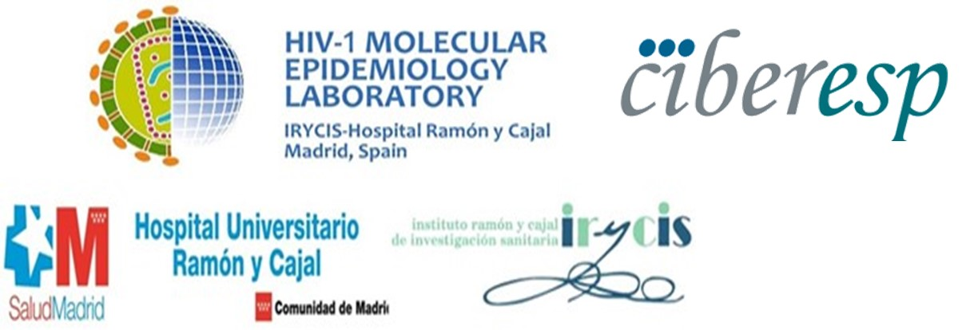
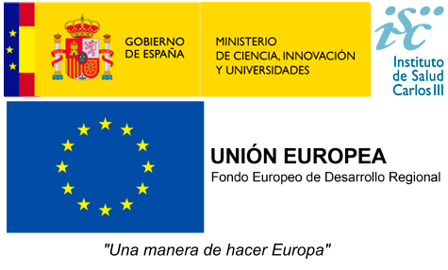
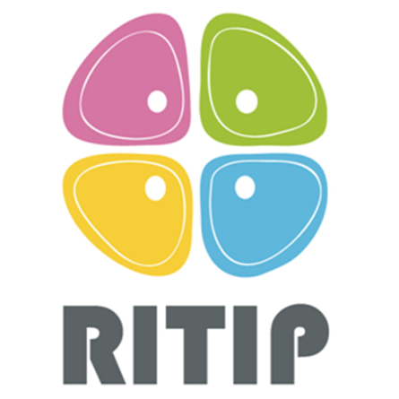
High drug resistance levels compromise the control of HIV in paediatric and adolescent population in Kinshasa, Democratic Republic of Congo
Rubio-Garrido M¹, Reina G², Rodriguez-Galet A¹, Valadés-Alcaraz A¹, López-Pintor JM¹, Ndarabu A³, Mbikayi S³, B. Makonda³, S. Carlos⁴, and Holguin A¹
¹HIV-1 Molecular Epidemiology Laboratory-Ramón y Cajal Institute for Health Research-Hospital Ramón y Cajal, Madrid, Spain, ²Clínica Universidad de Navarra, Navarra Institute for Health Research., Microbiology Department, Pamplona, Spain, ³Hospital Monkole, Kinshasa, The Democratic Republic of the Congo, ⁴Universidad de Navarra. Navarra Institute for Health Research, Department of Preventive Medicine and Public Health, Pamplona, Spain Contact: marina0705@hotmail.com ; africa.holguin@salud.madrid.org
Project PI18/00904
Background and objective
Despite significant advances in the prevention and treatment of HIV, some countries continue to experience serious gaps in antiretroviral therapy (ART) service delivery, including suboptimal treatment, drug stock-outs, limited or absent access to routine viral load quantification, and inadequate adherence to ART.
In the Democratic Republic of Congo (DRC), the coverage of people living with HIV receiving ART was 57% in 2018, but only 25% among children. In the DRC viraemia and drug resistance monitoring for ART optimization is absent during the clinical routine. So patients may spend months or even years on a failing ARV regimen, which benefit the emergence and transmission of HIV drug resistance.
The aim of this study is to analyze the prevalence of drug resistance mutations (DRM) to the main antiretroviral families and its therapeutical impact in children and adolescent population from Kinshasa (DRC). To find out the current situation of these populations in the DRC is particularly important because they are patients with a lifelong-treatment, with more years under ART than adults.
POSTER PEB0117
Methods
Between 2016 and 2019, dried blood spots (DBS) from 71 HIV-infected children/adolescents under clinical follow-up in pediatric units of Monkole and Kalembelembe Hospitals from Kinshasa were collected.
Genetic regions encoding viral proteins protease (PR), retrotranscriptase (RT), and integrase (IN) within HIV-1 pol gene were amplified by RT-PCR and nested-PCR with primers designed by WHO and ANRS.
DRM to protease inhibitors (PI), nucleoside analogs RT inhibitors (NRTI), to non-NRTI (NNRTI), and integrase inhibitors (INI), as well as the predicted susceptibility to antiretrovirals provided by Stanford-HIVdb-Program-v8.8 in these sequences carrying DRM were analyzed.
Statistical analyses were conducted using GraphPad Prism version 8.0.1.
Results
The median age at DBS collection was 14 years. HIV-1 sequences were recovered from 55 (77.5%) patients. All were under ART and with experience to NRTI and NNRTI, 9.1% had been exposed to PI and only one was INI-experienced. Despite ART, 89.1% presented >1,000cp/ml, reflecting potential virological failure according to the WHO (Table 1).
Most patients (61.2%) carried viruses with DRM to NRTI, mainly M184V (44.9%) and K70R/N (14.3%). DRM to NNRTI were present in 73.5% participants, with high prevalence of K103N/H/S (42.9%), Y181C (24.5%) and G190A (24.5%). The most frequent DRM to PI were M46I (8.3%) and I54V (5.6%). Accessory-DRM to INI were present in 15% subjects (Figure 1).
HIV-infected children and adolescents carried viruses with DRM to one (12.7%), two (43.6%), three (10.9%) or four (1.8%) antiretrovirals families.
We observed reduced predicted susceptibility in 75% of patients for nevirapine or efavirenz, 52.1% for emtricitabine or lamivudine, 50% for rilpivirine, and 12.5% with potential INIs resistance, despite the absence of INI exposure (Figure 2).
Conclusions
This study represents the first characterization of HIV drug resistance among HIV-infected children and adolescents in the DRC, providing the most recent data of ARV resistance and the first data for INI resistance in that country, which is opportune before the expected wide dolutegravir implementation in the DRC.
The high DRM prevalence observed in the study population could compromise 95-95-95 UNAIDS objectives in the DRC.
Our findings support alternative PI and INI-based ART regimens vs. RT inhibitors-based therapies in HIV-infected children and adolescent population in that country. However, the impact on found resistance to PI and INI in treated-patients without previous experience to PI or INI to future treatments including these drug families should be further explored.
The routine access to resistance monitoring is necessary for the best election of rescue ART in this vulnerable population, and to control resistant HIV spreading in the country. It remains important to reinforce adherence support, and to implement routine VL quantification and resistance testing in the DRC national guidelines, strengthening the country’s laboratory services. These improvements would help to control the spread of resistant viruses among new HIV infections.
Table 1. Demographic and virological characteristics of children and adolescents of the study cohort with available HIV sequence.
Figure 1. Drug resistance mutations to the main antiretroviral families in the study population.
 | Children [0-14] (%) | Adolescents [15-21] (%) | P value | Total cohort (%)
Total available sequences | 27 (100) | 28 (100) |  | 55 (100)
Female | 12 (44.4) | 17 (60.7) |  | 29 (52.7)
Median age at DBS collection [IQR] | 11 [9-12] | 16 [15-17] | ** | 14 [11-16]
HIV-1 viraemia >1,000c/ml | 25 (92.6) | 24 (85.7) |  | 49 (89.1)
HIV status in mothers
HIV+ | 12 (44.4) | 7 (25) |  | 19 (34.6)
HIV- | 2 (7.4) | 5 (17.9) |  | 7 (12.7)
unknown | 13 (48.2) | 16 (57.1) |  | 29 (52.7)
ART exposure at sampling
ART | 27 (100) | 28 (100) |  | 55 (100)
Median time under ART [IQR] | 6 [1-8] | 6 [1.3-10] |  | 6 [1-8.5]
Mean ARV exposure time (years)
To NRTI | 5.2 (0-12.2) | 6.2 (0-13.3) |  | 5.8 (0-13.3)
To NNRTI | 4.6 (0-11.2) | 6.2 (0-13.3) |  | 5.4 (0-13.3)
To PI | 0.9 (0-12.2) | 0.26 (0-3.4) |  | 0.6 (0-12.2)
To INI | 0 | 0.09 (0-2.7) |  | 0.05 (0-2.7)
NRTI experience
3TC | 27 (100) | 28 (100) |  | 55 (100)
AZT | 21 (77.8) | 26 (92.9) |  | 47 (85.5)
TDF | 13 (48.1) | 23 (82.1) | * | 36 (65.5)
DDI | 1 (3.7) | 0 |  | 1 (1.8)
ABC | 5 (18.5) | 2 (7.1) |  | 7 (12.7)
D4T | 0 | 4 (14.3) | * | 4 (7.3)
NNRTI experience
NVP | 21 (77.8) | 25 (89.3) |  | 46 (83.6)
EFV | 13 (48.1) | 23 (82.1) | * | 36 (65.5)
PI experience
LPV/r | 3 (11.1) | 2 (7.1) |  | 5 (9.1)
INI experience
DTG | 0 | 1 (3.4) |  | 1 (1.8)
Figure 2. Predicted ARV susceptibility by Stanford in patients with available sequence.
Legend Table 1. Data according to clinical reports. DRC, the Democratic Republic of Congo; DBS, dried blood Spot; ART, antiretroviral treatment; NRTI, nucleoside analogs transcriptase reverse inhibitors; NNRTI, non-NRTI; PI, Protease inhibitors; INI, integrase inhibitors; IQR; interquartile range; c/ml, HIV-1 RNA copies per milliliter; VL, viral load; ART, antiretroviral therapy; ARV, antiretroviral drug; 3TC, lamivudine; AZT, Zidovudine; TDF, Tenofovir; DDI, Didanosine; ABC, Abacavir; D4T, Stavudine; NVP, Nevirapine; EFV, Efavirez; LVP/r, Lopinavir/Ritonavir; DTG, Dolutegravir; PR, protease; RT, retrotranscriptase; IN, integrase. **, p<0.001; *, p<0.05. Viral load quantificated by Roche Cobas v2.0, Limit of quantification <20cp/ml. Corrected cp/ml plasma considering hematocrit.
Legend Figure 2. Predicted ARV susceptibility in 38PR/49RT/40IN available sequences from 55 patients under study. NRTI, nucleoside reverse transcriptase inhibitor; NNRTI, non-nucleoside reverse transcriptase inhibitor; PI, protease inhibitor; INI, integrase inhibitor; ATV/r, Atazanavir/Ritonavir; DRV, Darunavir; FPV, Fosamprenavir; IDV/r, Indinavir/Ritonavir; LVP/r, Lopinavir/Ritonavir; NFV, Nelfinavir; SQW, Saquinavir; TPV/r Tipranavir/Ritonavir; ABC, Abacavir; AZT, Zidobudine; D4T, Estavudine; DDI, Didanosine; FCT, Emtricitabine; 3TC, Lamivudine; TDF, Tenofovir; DOR: Doravirine; EFV, Enfavirez; ERT, Etravirine; NVP, Nevirapine; RPV, Rilpivirine; DGT, Dolutegravir; EVG, Elvitegravir; RAL, Raltegravir.
Legend Figure 1. DRM, drug resistance mutation; NRTI, nucleoside analog transcriptase reverse inhibitors; NNRTI, non-NRTI;
PI, Protease inhibitors; INI, integrase inhibitors. Available sequences in 55 patients under study: 38PR, 49RT and 40IN.
PRESENTED AT THE 23RD INTERNATIONAL AIDS CONFERENCE (AIDS 2020) | 6-10 JULY 2020

